Slide 1



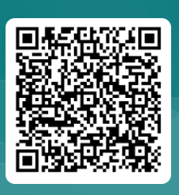
JBU Activity
Chapter Robotics: 101
Sign in
https://tinyurl.com/msnh49bd

Slide 2
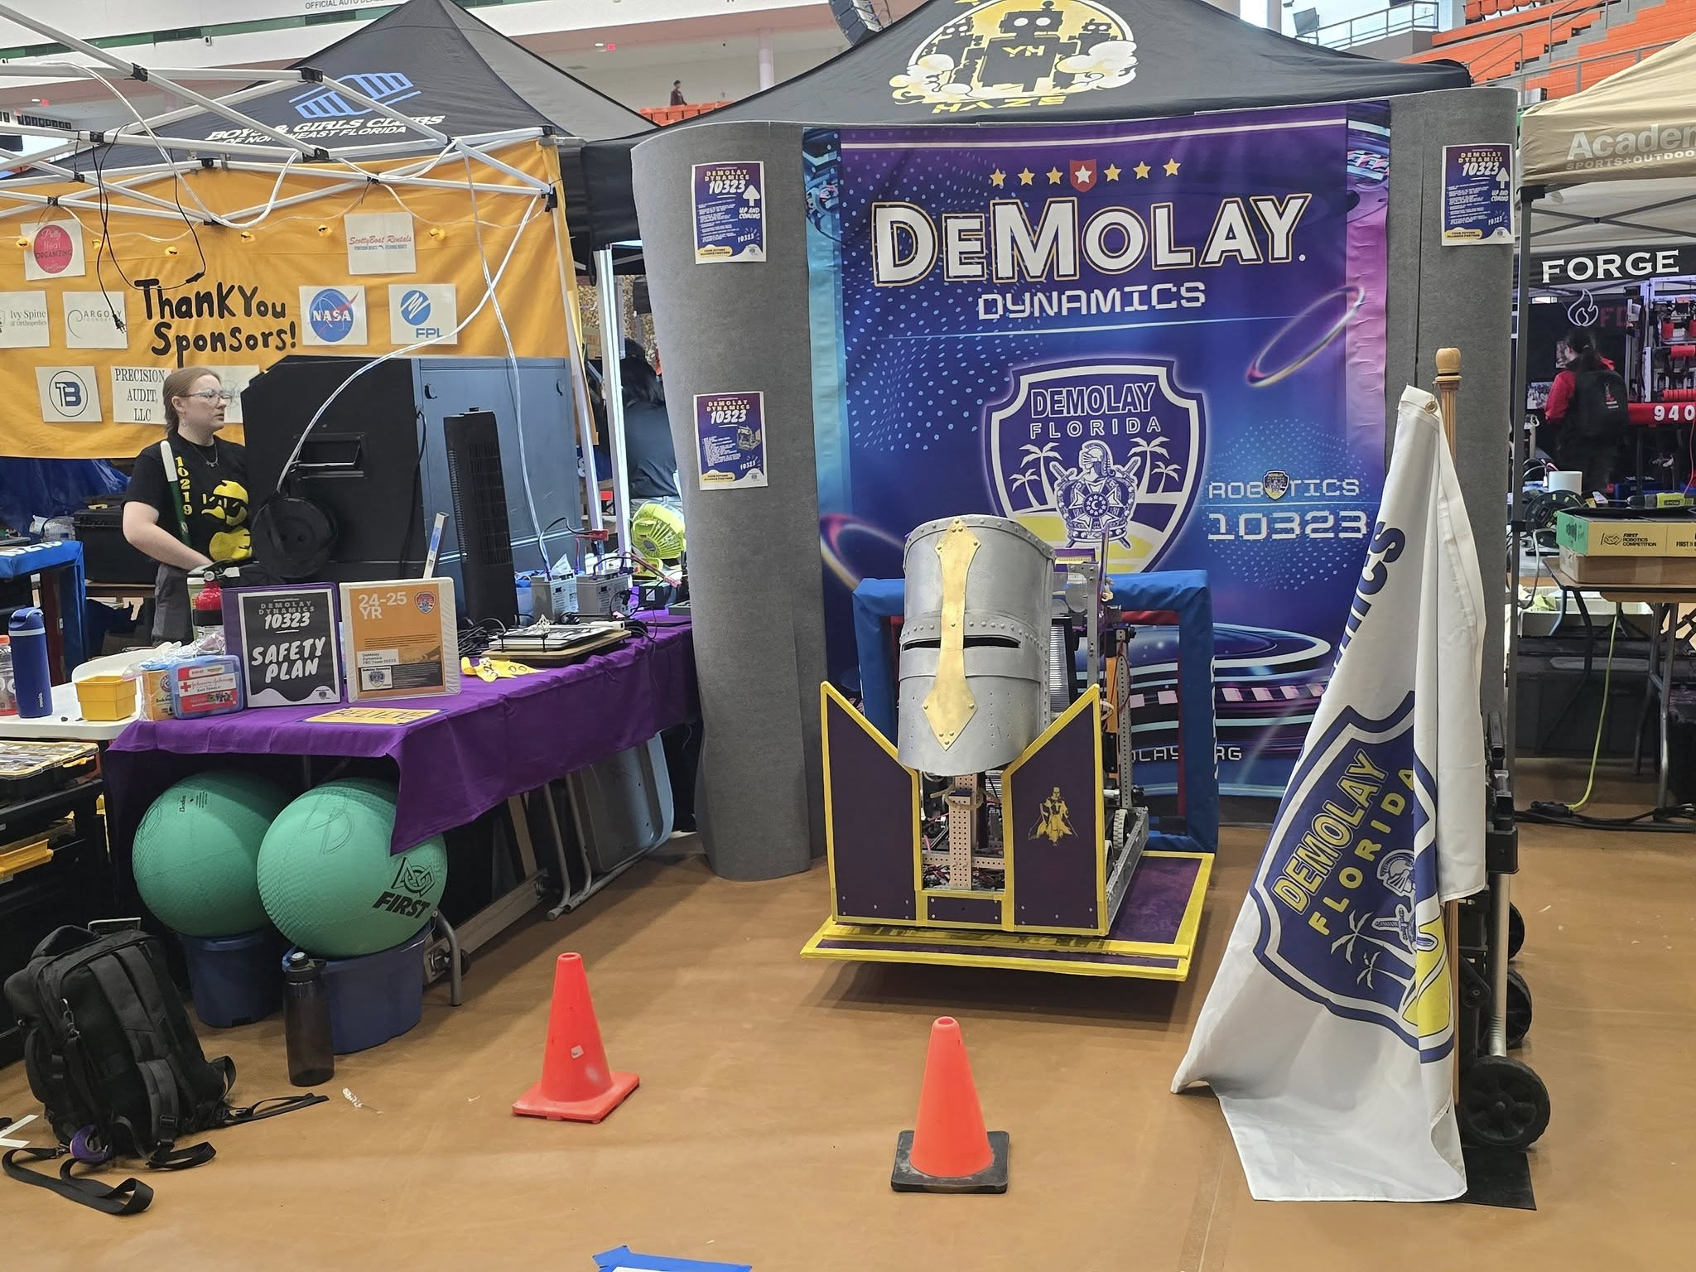
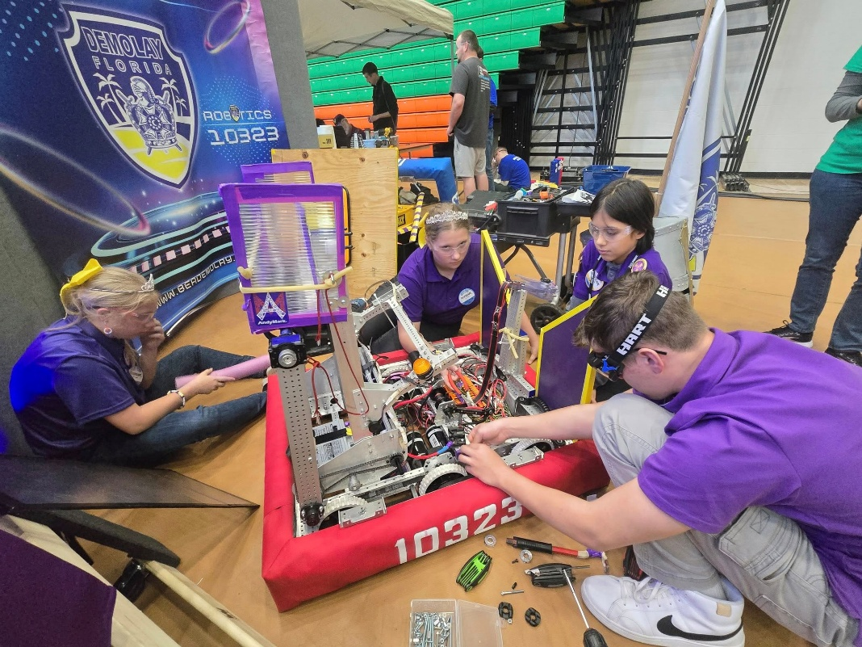

Slide 3
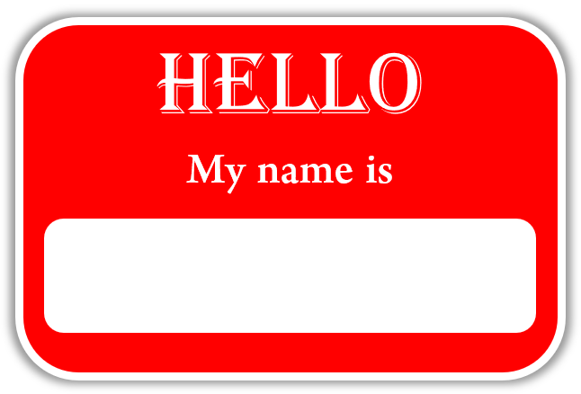
Introductions
Name
Chapter
Quick thoughts on STEM
What is your STEM Skill !!!

Slide 4
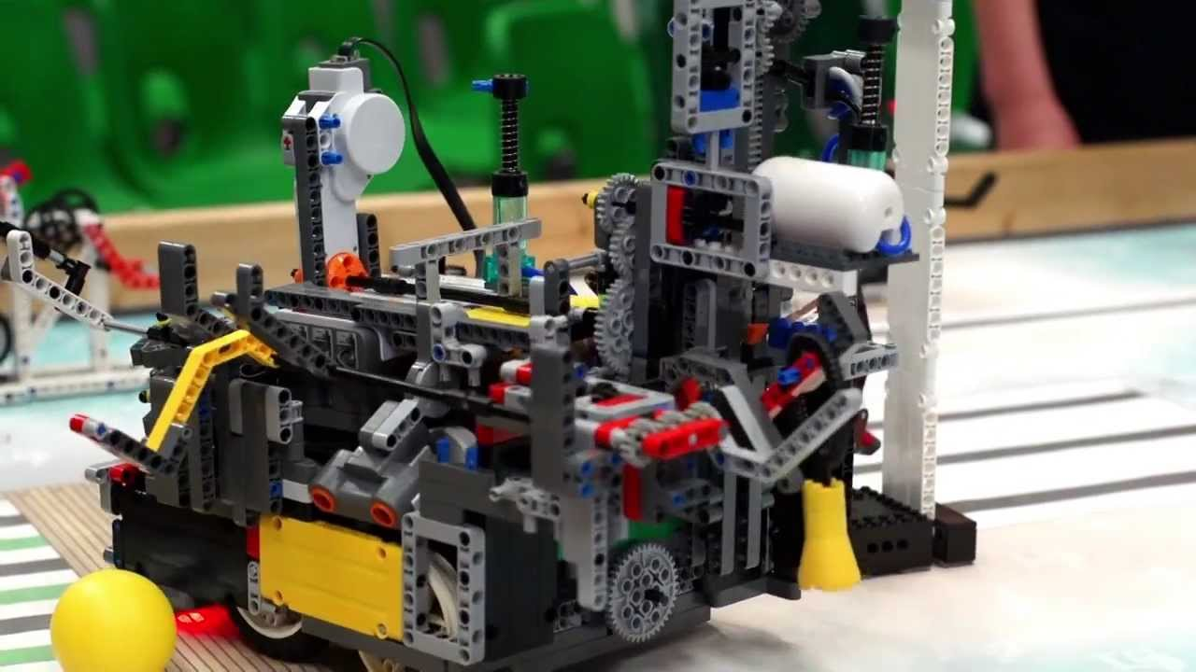
Benefits of a DeMolay Robotics Team
Promotes teamwork and collaboration
Enhances problem-solving and critical-thinking skills
Provides hands-on STEM learning experiences
Builds leadership and project management skills
Strengthens community ties and outreach

Slide 5
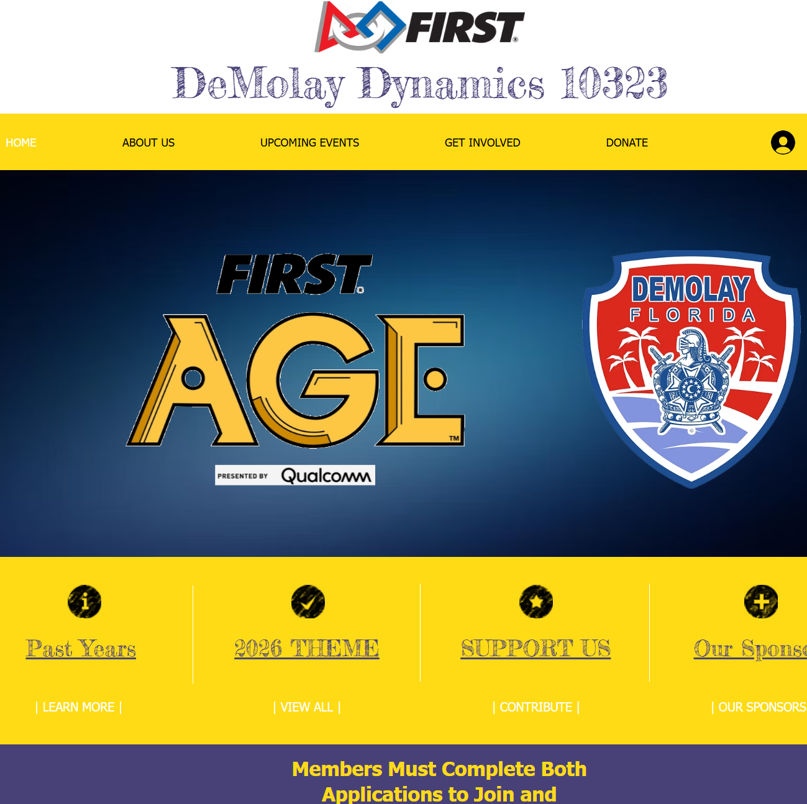
Our Webpage
DEMOLAY10323.com

Slide 6
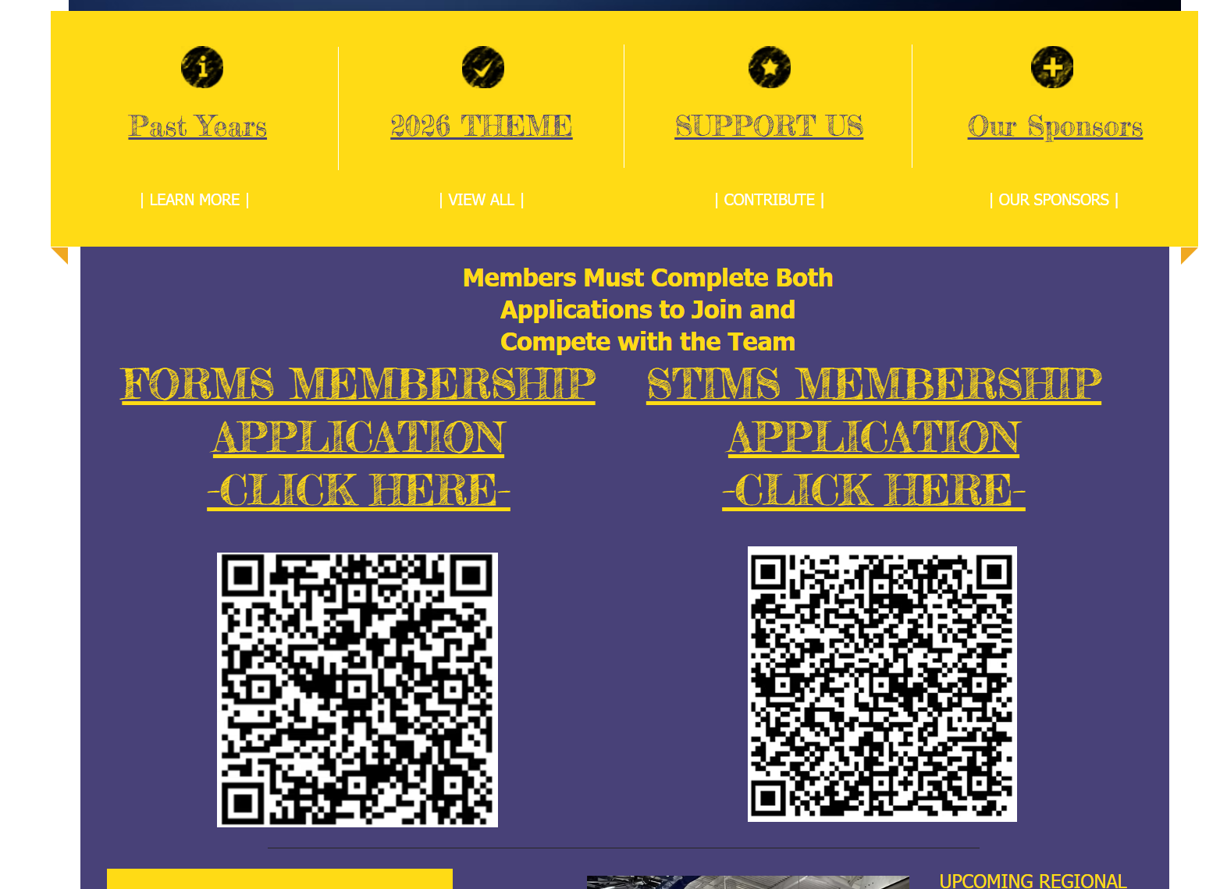

Slide 7
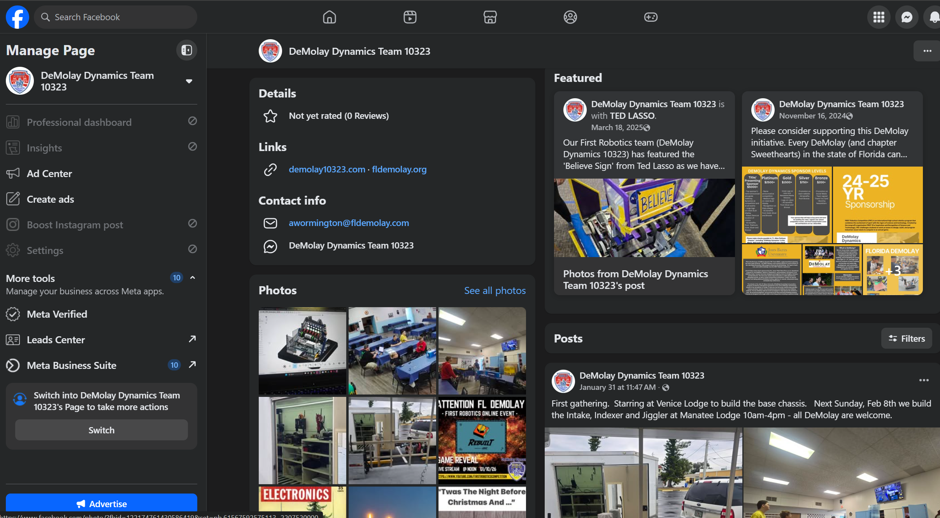

Slide 8
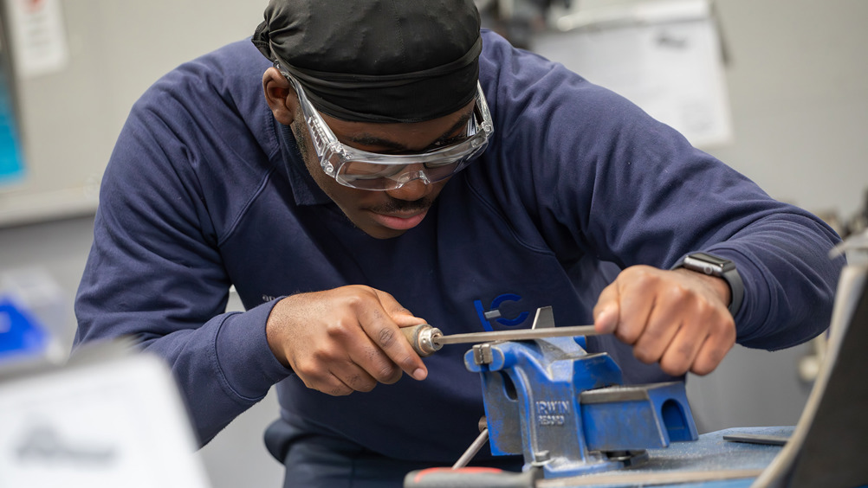
Membership via Robotics
Invite potential members
Exclusive access to International Competition
Come for the Robotics Experience – Stay for the DeMolay Journey!!!!

Slide 9
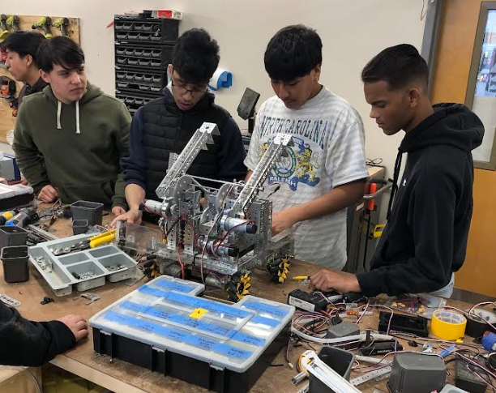
Community Engagement and Outreach
Hosting workshops and demonstrations
Partnering with local schools and organizations
Sharing your journey on social media and local media

Slide 10
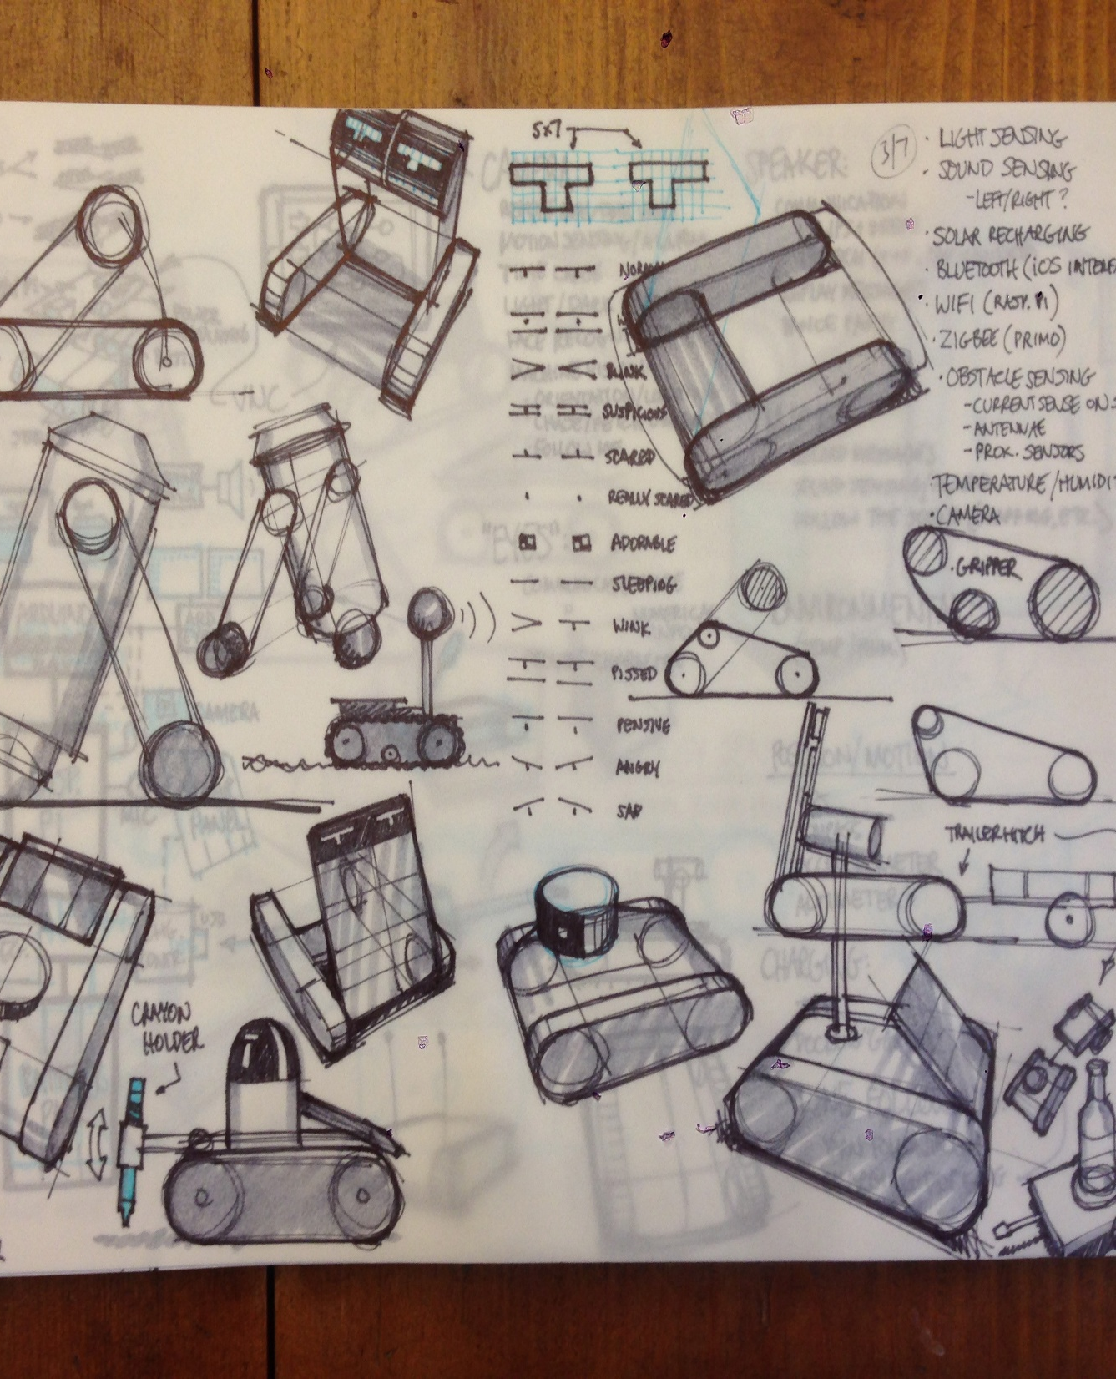
Designing and Building Your Robot
Understanding the challenge and rules
Brainstorming and sketching designs
Prototyping and testing
Iteration and improvement

Slide 11
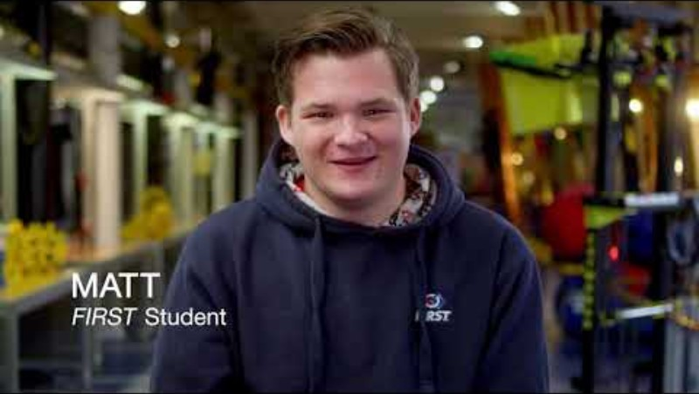

Slide 12
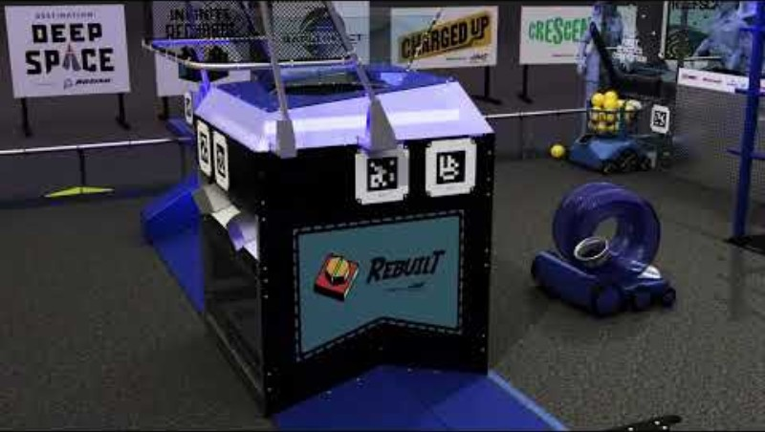

Slide 13
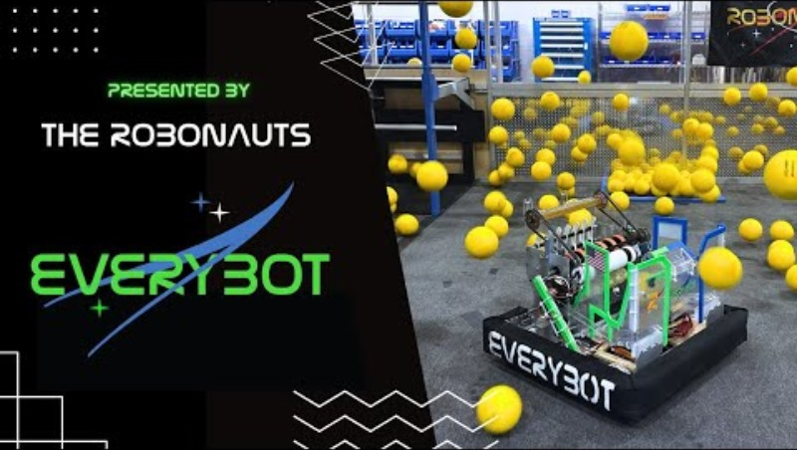

Slide 14
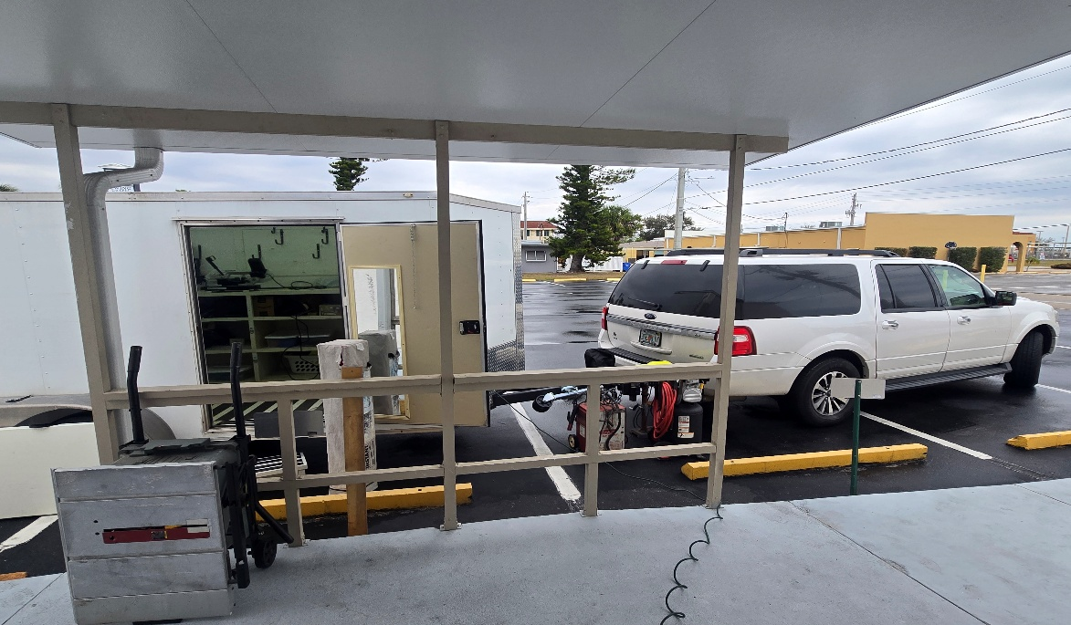
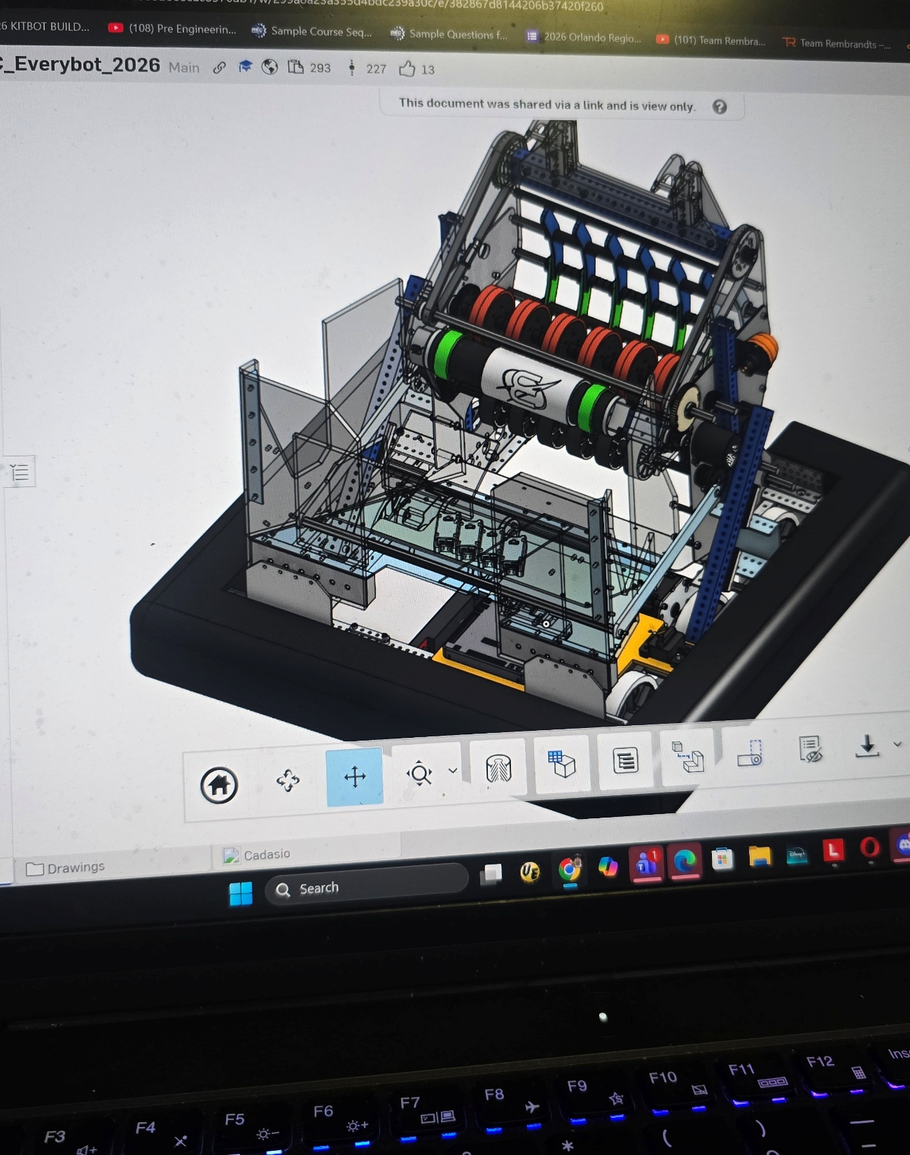
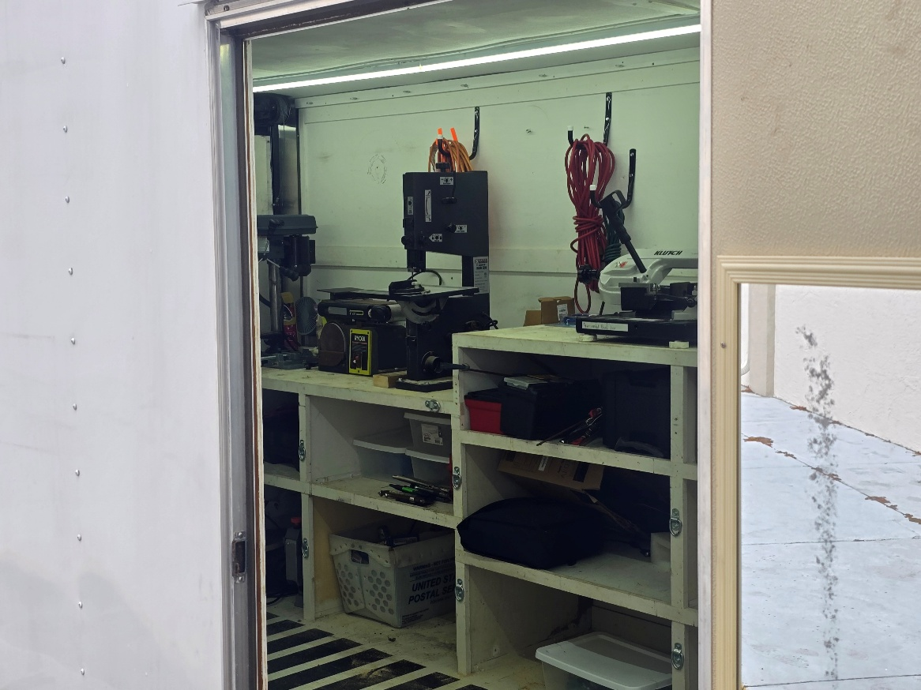
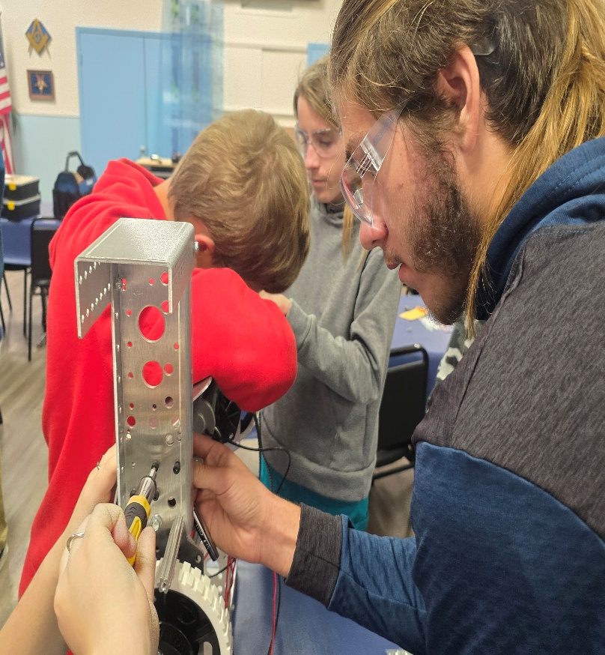

Slide 15
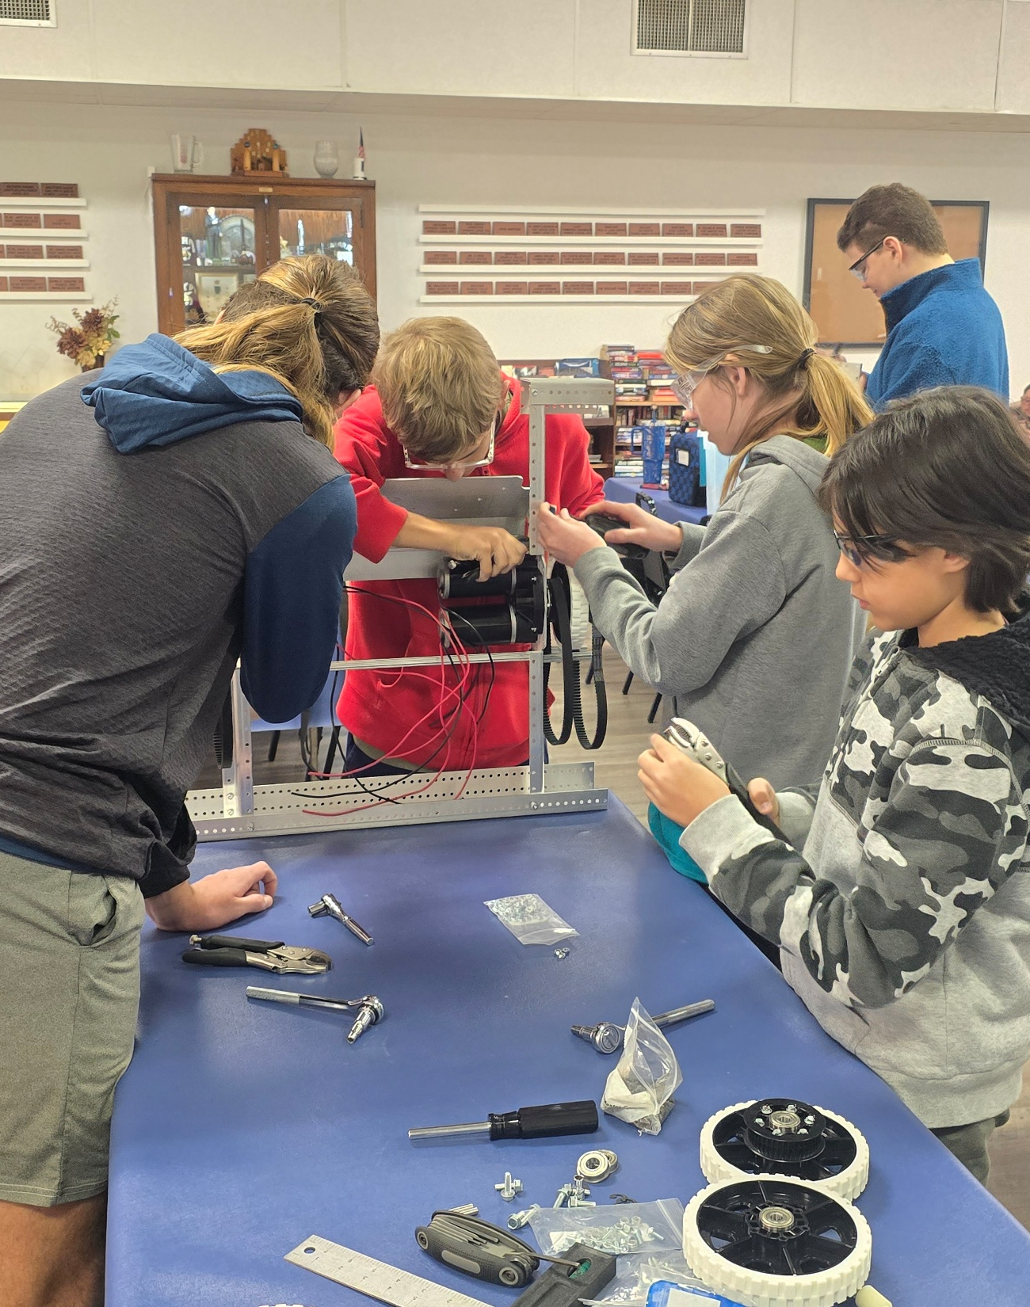
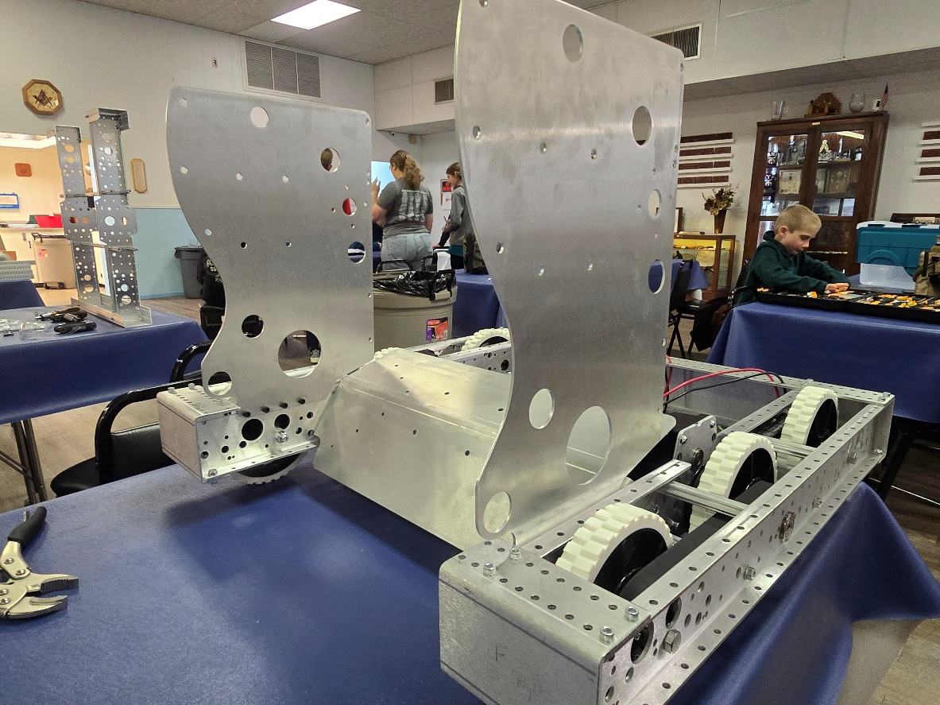
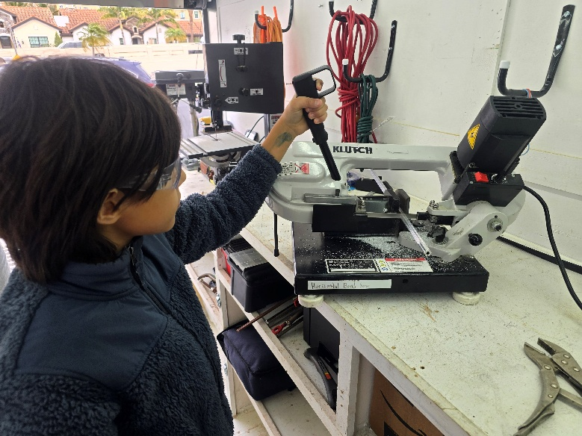
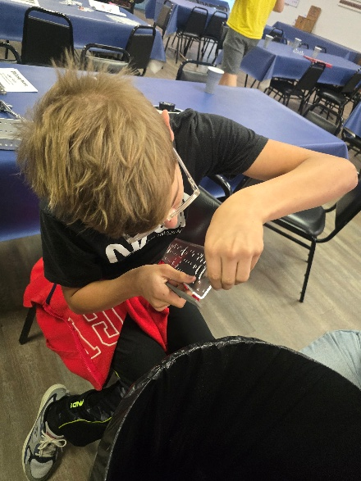

Slide 16
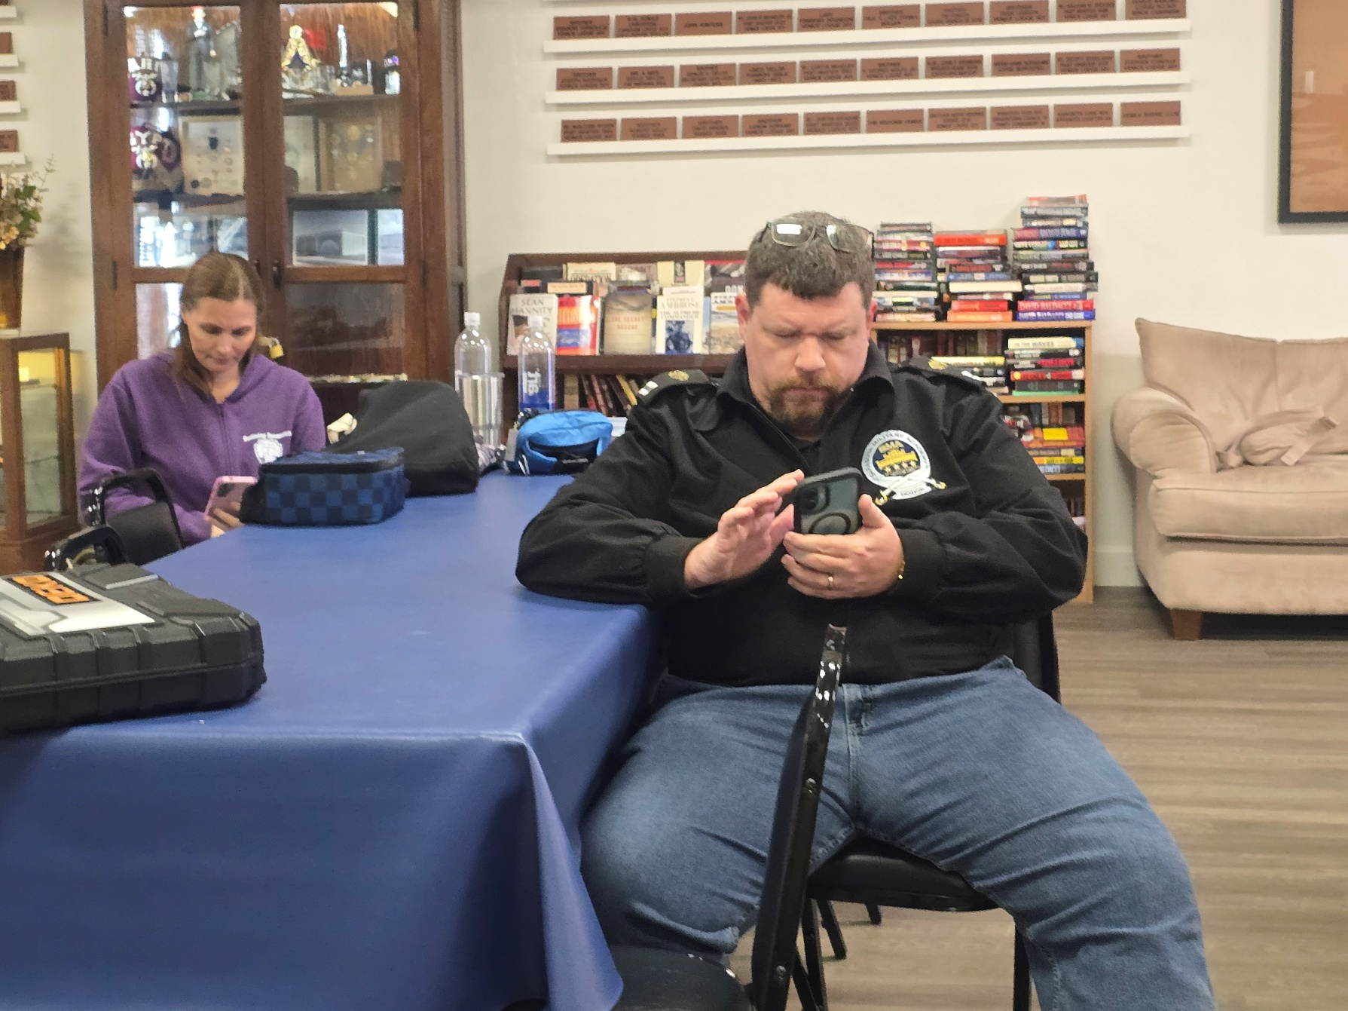
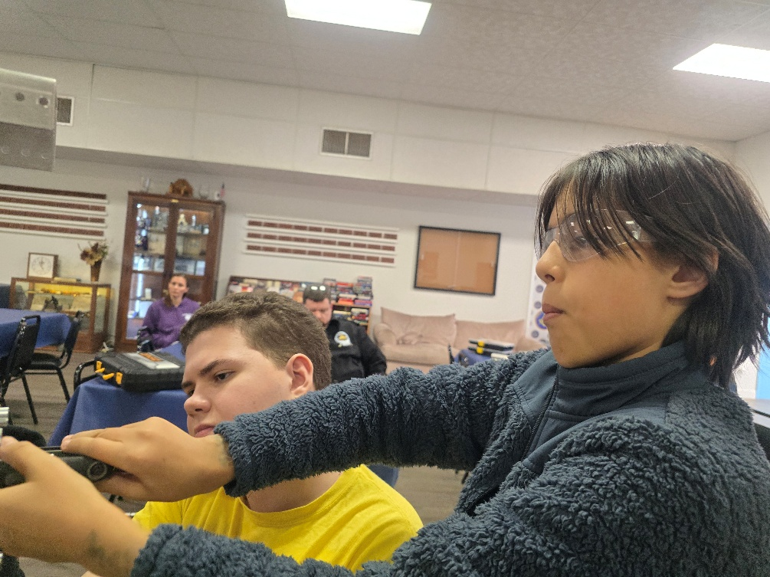

Slide 17
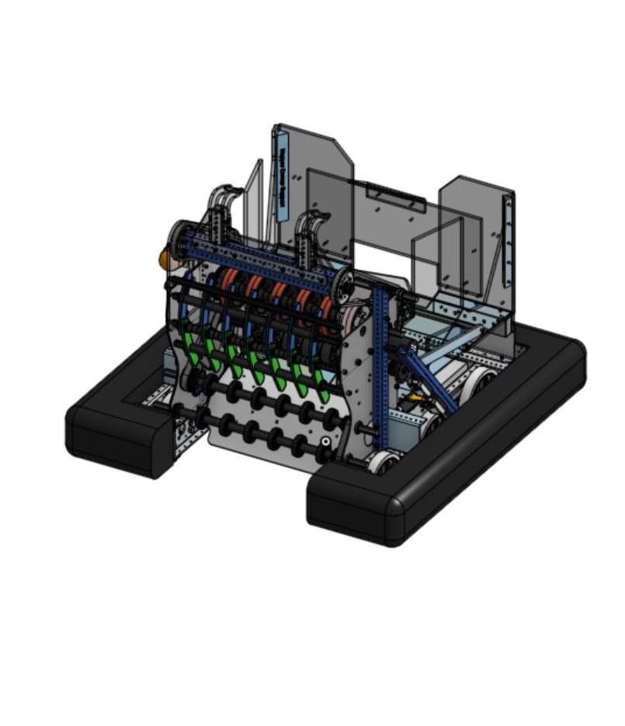
Proposed Build Dates
Feb 8th Intake, Indexer, and Jiggler
Manatee (Sunday Feb 8th) *Approved*
Feb 14 Valentines day … What’s that .. Would anyone come?
Feb 15 Initiation
Feb 21st Launcher and Climb Structure Nitram Lodge *confirming*
Feb 28-1 Wiring & Programing / Bumper
A Miami Lodge *pending*
March 7th Bumper / Pit Layout Orlando Area
TBD (Bahia Shrine Club??) *pending*
March 8th (unfinished work) Venice Lodge *pending*
March 14-15 Drive Practice Tampa Science Lab

Slide 18
Proposed Build Dates
3-4 Nights per competition
Travel with Chapter
or parents
Just pay for your hotel
and food
Orlando Regional:
March 19th - 21st (Setup on 18th)
** Addition Financial Arena at UCF
https://www.orlandofrc.org/
​South Florida Regional:
April 9th - 11th (Setup on 8th)
Watsco Center - University of Miami
https://soflofrc.firstinflorida.org/
*would like to attend* If funding allows
Tallahassee Regional:
March 14th – March 19th ** (Setup on 15th)
** Alfred Lawson Jr Multipurpose Center**
https://tallahasseefrc.org/

Slide 19
This concludes our presentation.
Thank you for your attention.
  This presentation acknowledges authority and yields allegiance to DeMolay International, of which Frank S. Land was the founder.
  © 2021

